Slide 1
Text Books:
1. Computer Science, A Structured Programming Approach using C, B.A. Forouzan and R.F. Gilberg, Third Edition, Thomson.
2. The C Programming Language, B.W. Kernighan, Dennis M.Ritchie, PHI/Pearson Education.
References:
1. Let us C by Yashwanth P. Kanetkar 8th Edition BPB Publications.
2. Understanding Pointers in C by Yashwanth P. Kanetkar.

Slide 2

UNIT-1

Slide 3
Topics to be covered in UNIT-1
Computer Fundamentals:
  Computer Systems: Computer Hardware, Computer Software,
  Computer Environments:
    Personal Computing Environment, Time-sharing Environment, Client/Server Environment, Distributed Computing,
  Computer Languages:
    Machine Languages, Symbolic Languages, High-Level Languages,
  Creating and Running Programs:
    Writing, editing, compiling, linking, and executing programs,
  System Development – SDLC.
Problem Solving Techniques:
  Algorithms, pseudo code, flowcharts
  Simple illustrations and domain problems like:
    Sum of digits of a number,
    Nature of quadratic equations,
    Income Tax Problem, Standard Deviation.

Slide 4
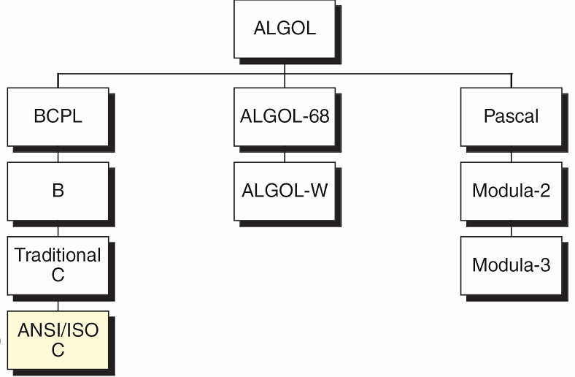
Overview of C
Preceded by BCPL and B
Developed by Dennis Ritchie
  Bell Labs in 1972
Used in UNIX, Networks.
Taxonomy of the C Language

Slide 5

What is a Computer?
A computer is an electronic device or programmable machine. It allows the user to store all sorts of information and then process that information or carry out actions with the information such as calculating numbers or organizing words.

Slide 6
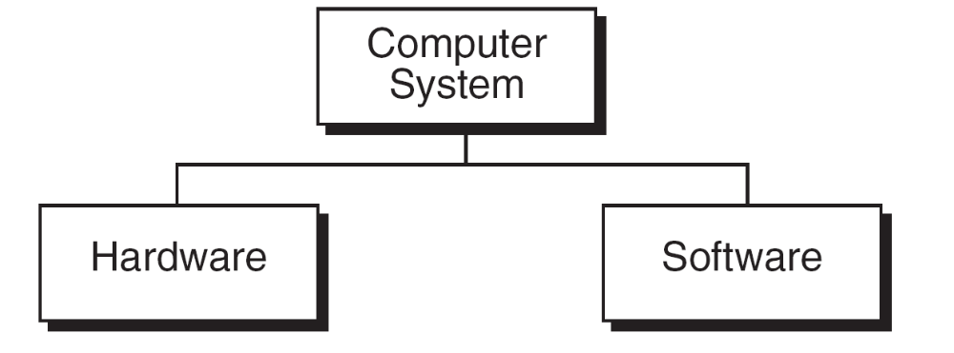
Computer Systems
A computer system consists of hardware and software.
Hardware refers to any physical, electrical components of the computer.
For example keyboard, mouse, cabinet of computer is considered as hardware.
Software refers to a program or set of instructions that is written to achieve a specified task.

Slide 7
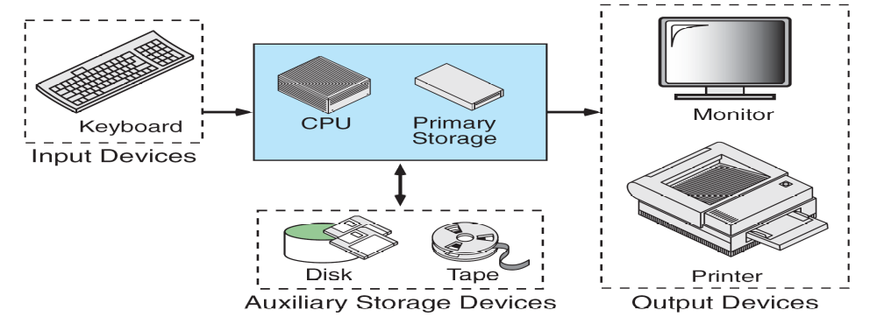
Computer Hardware
Hardware refers to any physical, electrical components of the computer.
The physical equipments required to create, use, manipulate and store the electronic data.
Hardware consist of five parts:
    Input Devices, CPU (Central Processing Unit),
    Output Devices, Memory, Storage Devices.

Slide 8
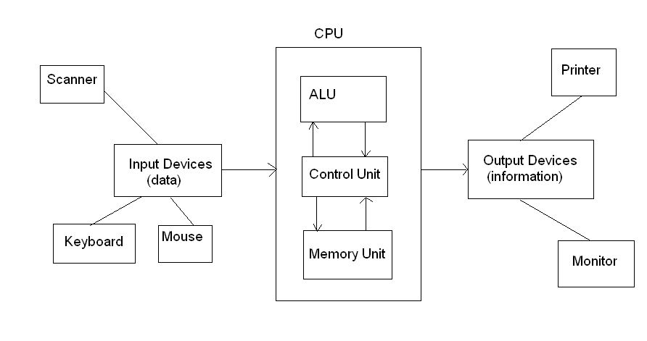
  COMPUTER ARCHITECTURE (BLOCK DIAGRAM)

Slide 9
Input Devices:
  The input device is used to enter data into a computer.
  The devices like keyboard, mouse and scanner are commonly used input devices.
Central Processing Unit:
  It is the main part of the computer.
  It’s main function is to execute programs stored in the main memory.
  It consists of three functional units: ALU, CU and MU.
Arithmetic and Logic Unit (ALU):
  It performs arithmetic and logical operations on the data.
Control Unit:
  It controls the overall activities of the components of the computer.
Memory Unit:
  It is used to hold the waiting data to be processed.

Slide 10
Memory: There are two types of memories.
  Volatile Memory
  Non-volatile Memory
Volatile Memory: It means that the information present in these types
of memory devices is deleted as soon as the power is switched off.
Non-volatile Memory: It means that the information present in these
types of memory devices is not lost as soon as the power is switched off.
Types of Storage Devices:
    Primary Storage or Main Memory.
    Auxiliary Storage or Secondary Storage
    Cache memory
    Registers

Slide 11
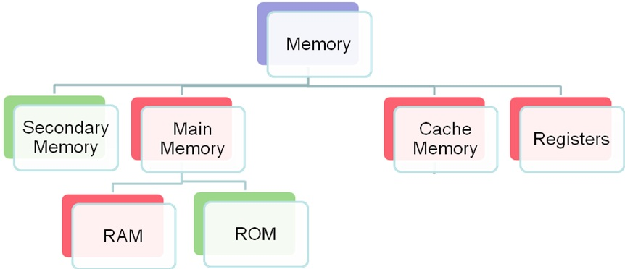
Types of Storage Devices:

Slide 12
Primary Storage/Main Memory:
  This is the place where the data is stored temporarily during processing.
  Primary memory (main memory) is available in two forms: RAM and ROM.
RAM (Random Access Memory):
  It is a temporary storage medium in a computer.
  The data which is to be processed by the computer is transferred from a storage device to RAM during data processing.
  RAM is a volatile memory.
ROM (Read Only Memory) :
  It is a permanent storage medium which stores start up programs.
  These programs are loaded when computer is switched on.
  ROM is non-volatile memory.

Slide 13
Auxiliary Storage/Secondary Memory:
  It is the place where data to be stored permanently. Ex: Disk,tapes.
Cache Memory:
  It is a memory placed between CPU and main memory.
  It is faster compared to the primary memory.
  Parts of the program or data that need to be accessed repeatedly are stored in cache memory.
  It is a volatile memory.
Registers:
  Registers are small memory units internally available within the
processor.
  It is a volatile memory.
Output Devices:
  It is used to display or print the result.
  Monitor, printer and plotter are commonly used output devices.
  If output is shown on the screen it is called soft copy. If it is printed on the paper is called hard copy.

Slide 14
Computer Software
Software refers to a program or set of instructions that is written to achieve a specified task.
These instructions need to be written in a programming language that the computer can understand.
Programming Language: An artificial set of rules, vocabulary and
syntax used to instruct the computer to execute certain tasks.
Software is mainly categorized into two groups.
    System Software
    Application Software

Slide 15
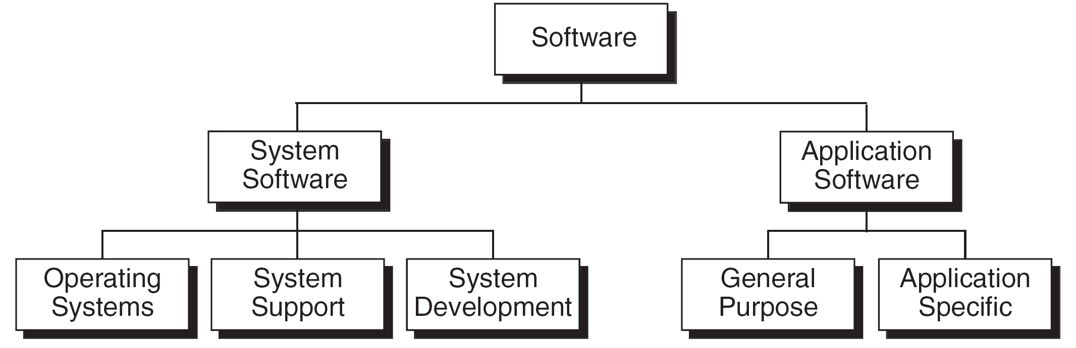
Computer Software (contd)

Slide 16
System Software
System Software consists of programs that manage the hardware resources of a computer and perform required information processing tasks.
It is divided in to three categories:
1. Operating System:
  It consists of programs and data, it runs on the computer and manages the computer hardware.
  It keeps the system operating in an efficient manner while allowing the users access to the same system.
2. System Support Software:
  It provides all the utilities and other operations that enable the computer to function. Ex- Disk formatting programs.
3. System Development Software:
  It includes language translators used convert into machine language for execution, debugging tools to ensure that the programs are error-free. Ex- Compilers.

Slide 17
Application Software
Application Software is responsible for helping the users in solving the general or specific problems.
It is divided in to two categories:
1. General Purpose Software:
  It can be used for several purposes. That is the same software can be used in more than one application.
  Ex- Word Processor, DBMS.
2. Application Specific Software:
  It can be used only for its intended purpose.
  Ex- Library Automations System

Slide 18
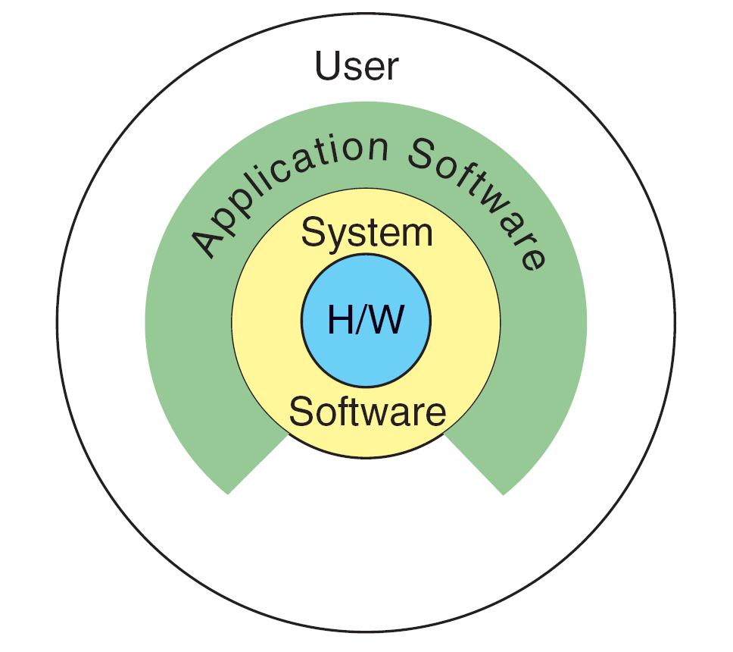
Relationship between System and Application Software

Slide 19
Computing Environment
In the early days of computers, there was only one environment, The mainframe computer hidden in a central computing department.
With the advent of minicomputers and personal computers, the environment has been changed.
In this section we describe several different environments.
1. Personal Computing Environment
2. Time-Sharing Environment
3. Client-Server Environment
4. Distributed Environment

Slide 20
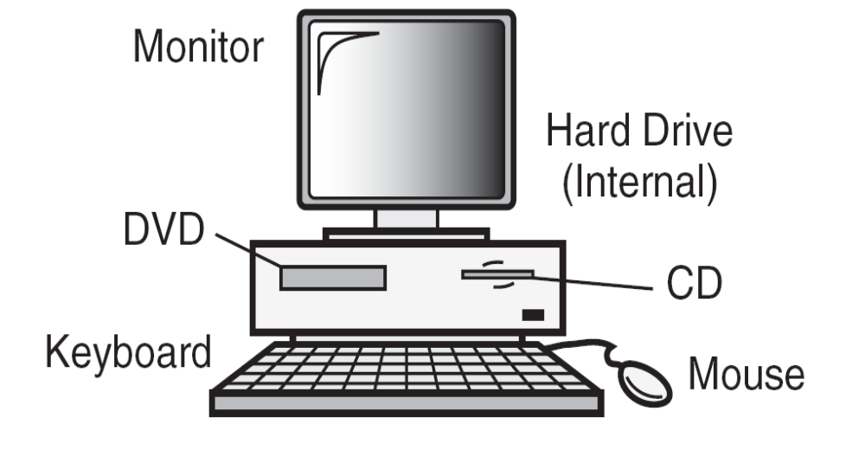
1. Personal Computing Environment
Fig: Personal computing environment
In this environment, a single personal computer is maintained and to
which all the computer hardware components are tied together.
You can work on PC independently that is you can perform which
ever operations you want.

Slide 21
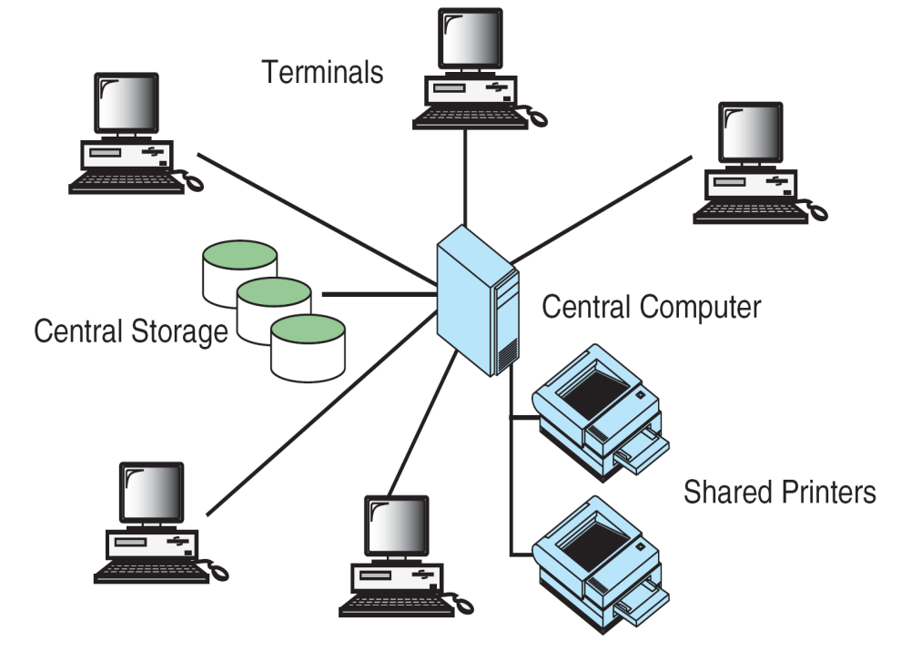
2. Time Sharing Environment
Time-sharing Environment

Slide 22
Time Sharing Environment (Contd..)
In this environment many users are connected to one or more computers.
That is concurrent use of a computer by more than one user, all users share the computer's time.
The output devices like printers and auxiliary storage devices are shared by all the users.
All the shared resources are connected to central computer so that it must control the shared resources in an efficient manner.
In which all the computing must done by the central computer.
Example: In the lab, the server computer is shared by all the students.

Slide 23
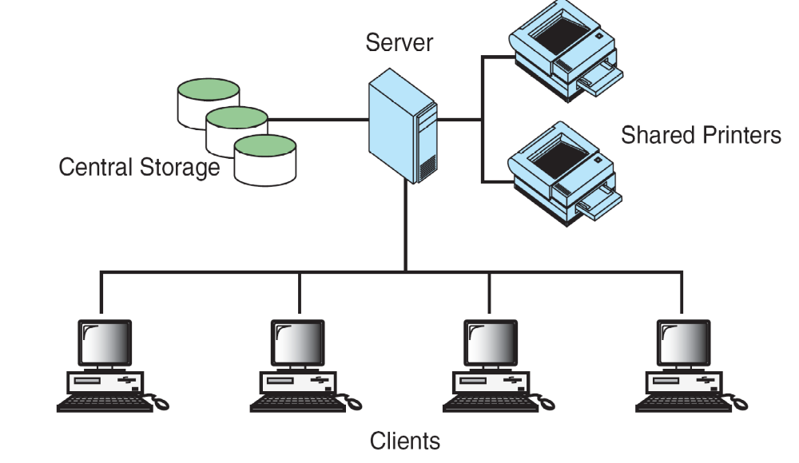
3. Client/Server Environment

Slide 24
Client/Server Environment (Contd..)
In this environment, all the computing functions are shared between
the central computer and user computers.
The users are given personal computer or work station which are
known as clients.
The central computer is called as server.
This environment is much faster than the time sharing environment
as the work is shared between the user computers and the server.

Slide 25
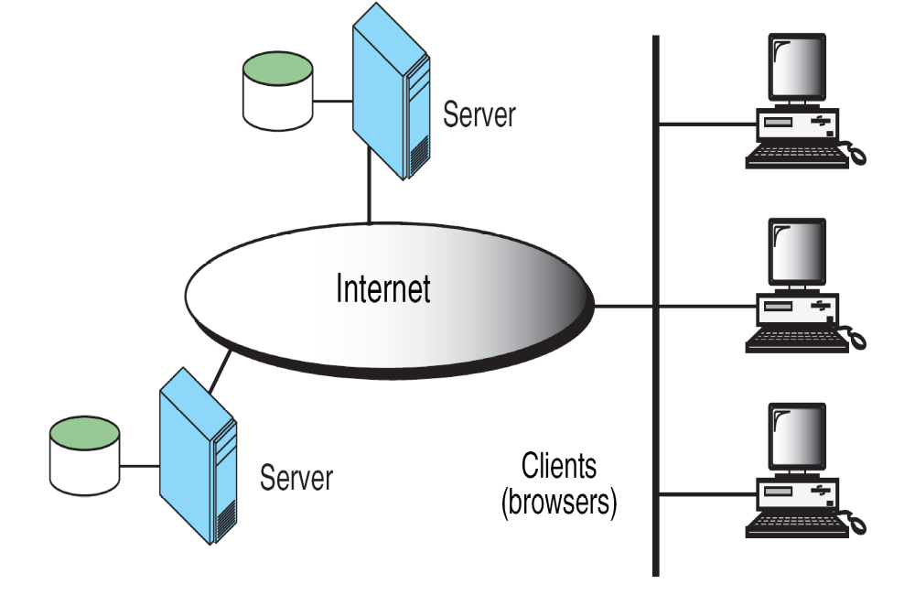
4. Distributed Computing
It is the integration of different clients and different servers.
The connectivity between these different users and different
servers is provided by the internet through out the world.

Slide 26
Computer Languages
A program’s instructions need to be written in a programming language that the computer can understand.
The first programming language is machine language.
Computer languages were evolved from machine language to natural language ( like English language).
Computer Languages are basically divided into three categories:
  Machine language
  Symbolic language
  High level languages

Slide 27
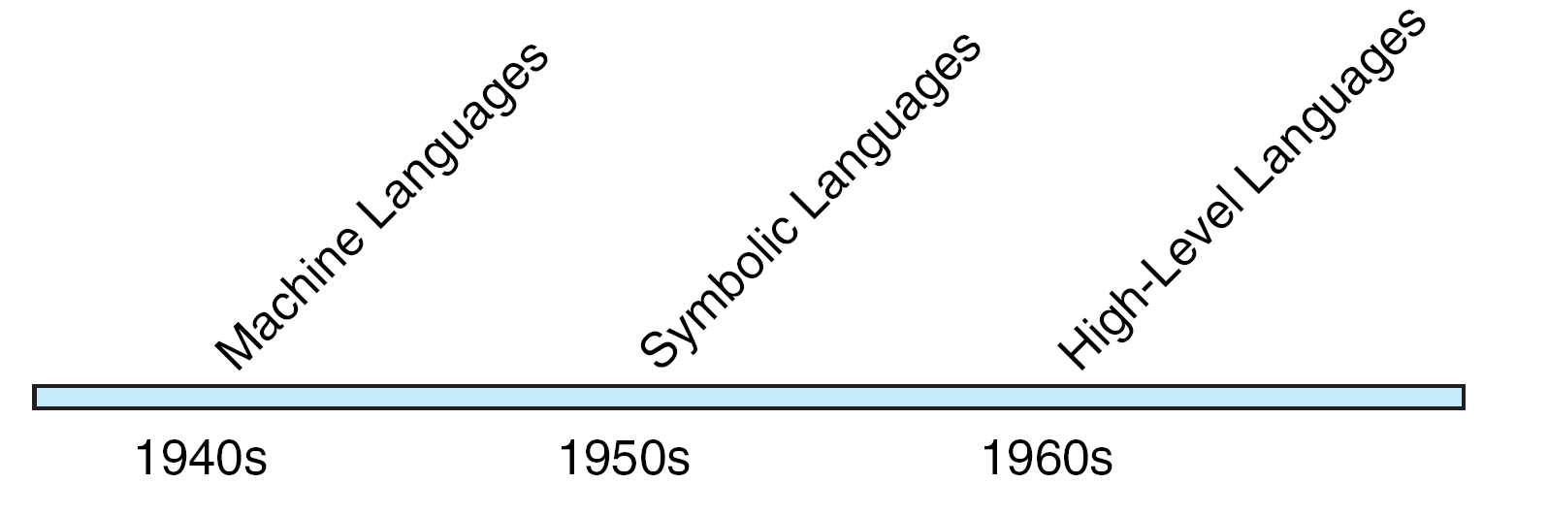
Computer Language Evolution

Slide 28
Machine Language
Machine language was the first programming language in the early days of computers.
The language which is understand by the computer hardware is called machine language.
It consists of 0’s and 1’s.
Internally the computer consists of circuits which are made up of switches, transistors and other electronic devices that can be in one of the two states: off or on, where off is represented by 0 and on is represented by 1.

Slide 29
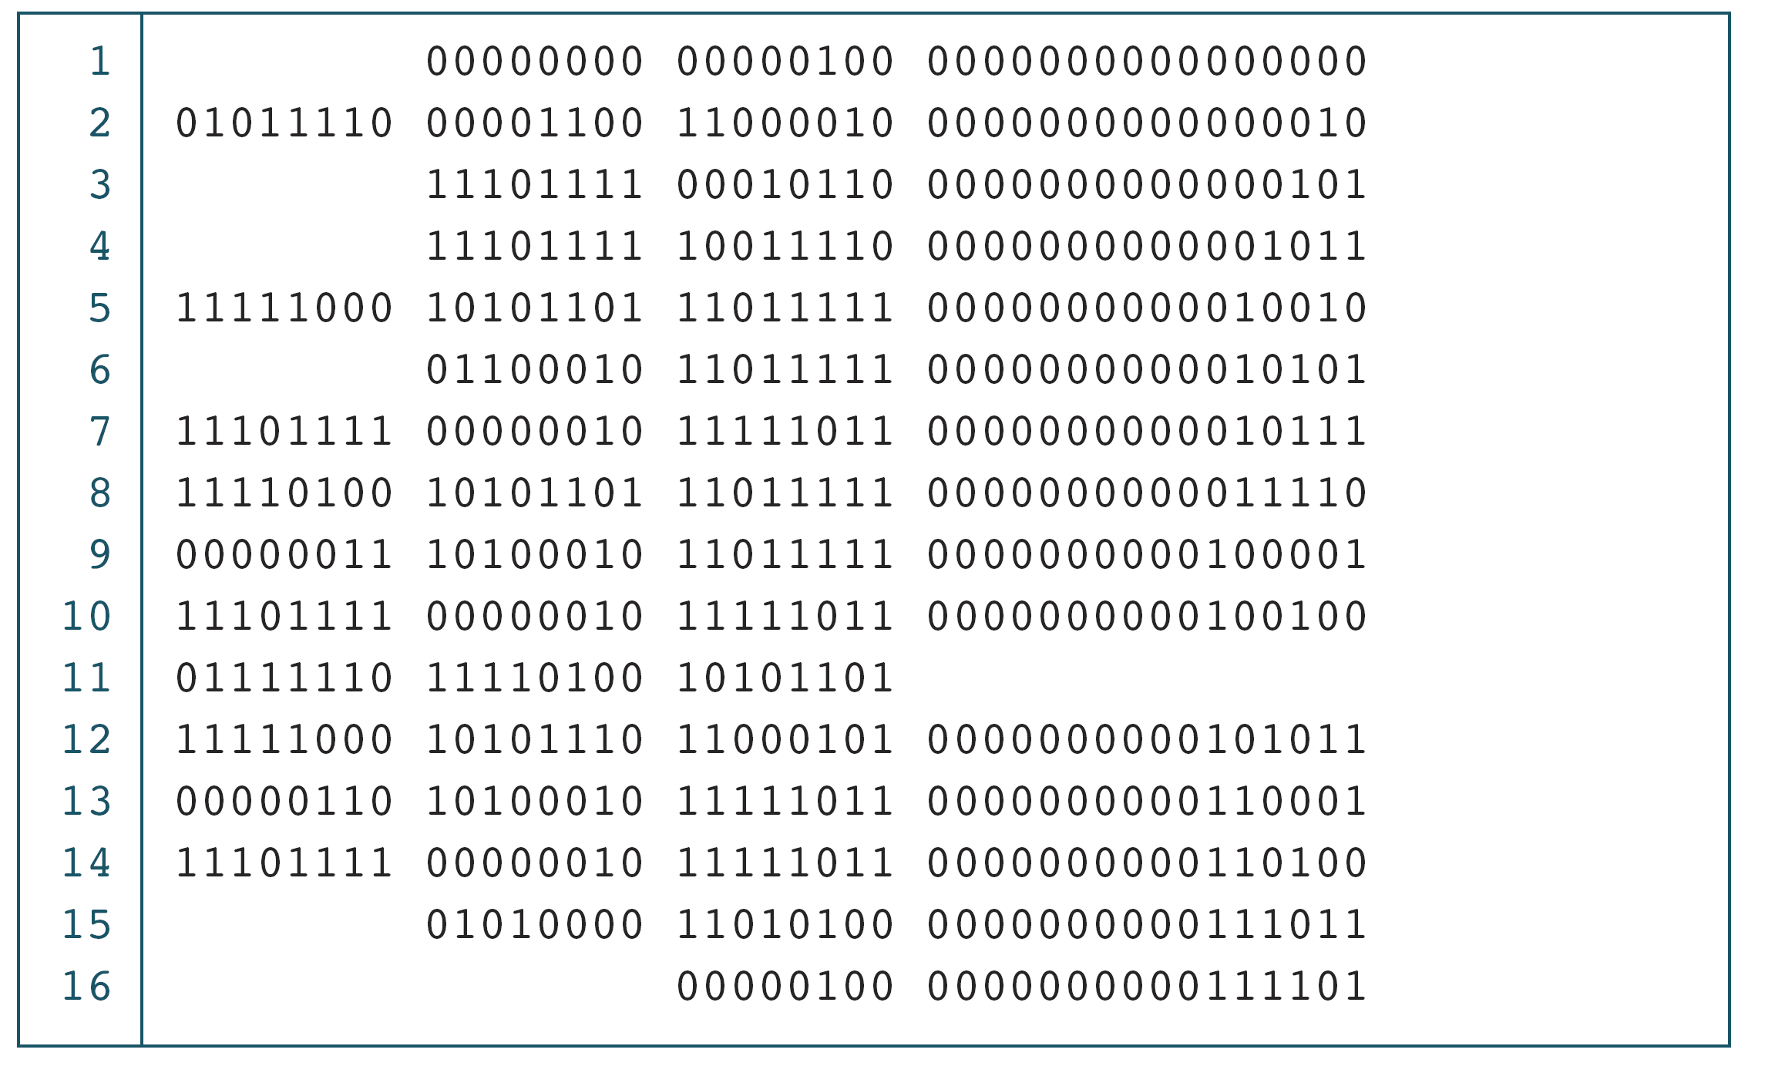
The Multiplication Program in Machine Language
Example for Machine Language

Slide 30
Symbolic Language
Writing program in machine language is difficult.
The language which is represented using symbols or mnemonics is called as symbolic language.
This language is not understandable by the computer .
Hence, it must be translated to the machine language using the assembler.
Another name of the symbolic language is assembly language.

Slide 31
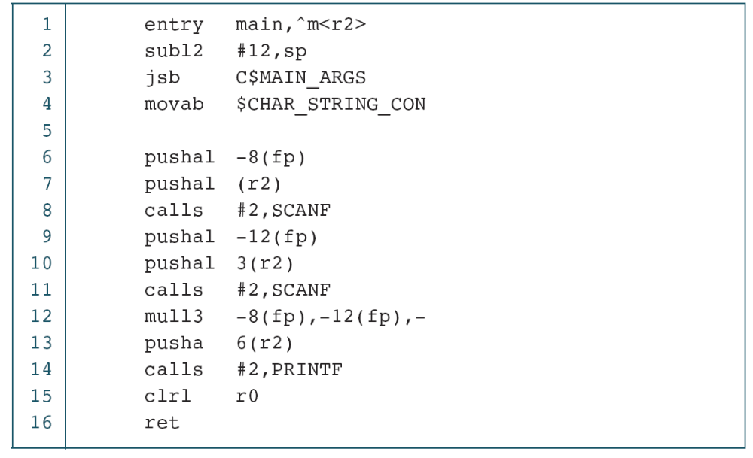
The Multiplication Program in Symbolic Language
Example for Symbolic Language

Slide 32
High Level Language
It is like natural language which can understandable by the programmer.
The High Level Language instructions are not understandable by the machine.
Compiler is used to convert High Level Language instructions into the Machine Language instructions.
First High Level Language is FORTRAN.
Examples for High Level Languages are : C, C++,JAVA, COBOL etc.,

Slide 33
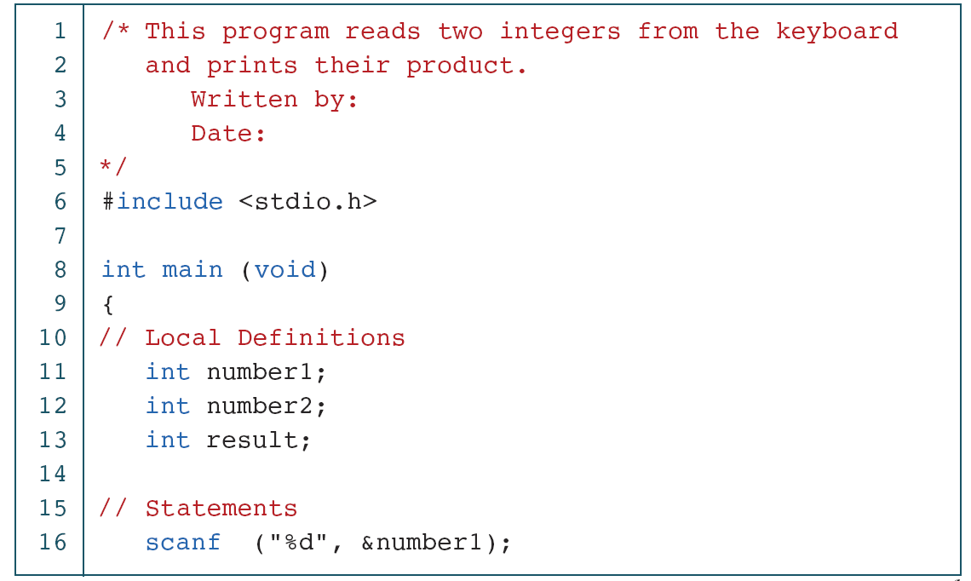
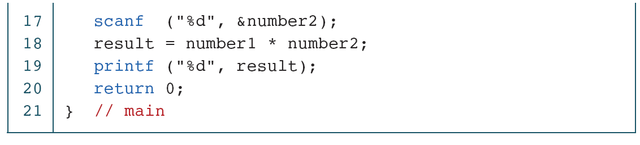
The Multiplication Program in C

Slide 34
Creating and Running Programs
Creating and running programs takes place in 4 steps.
  Writing and Editing the program.
  Compiling.
  Linking the program with the required library functions.
  Executing the program.

Slide 35
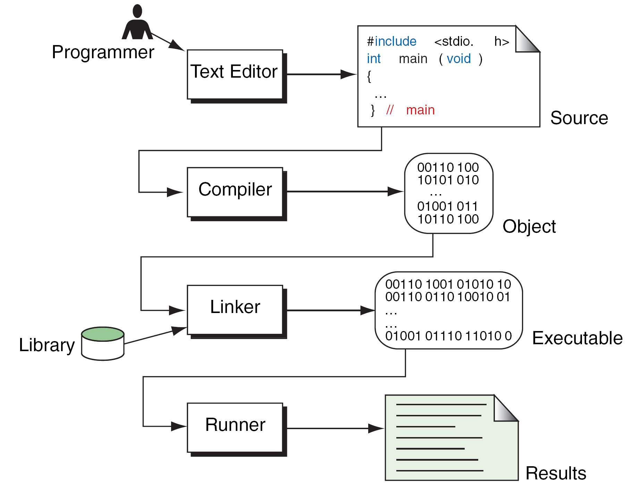
Building a C Program

Slide 36
1. Writing and Editing the program
Software used to write programs is known as a text editor, where you can type, edit and store the data.
You can write a C program in text editor and save that file on to the disk with “.c” extension. This file is called source file.

Slide 37
2. Compiling Program
Compiler is used to convert High Level Language instructions into the Machine Language instructions.
It could complete its task in two steps.
i) Preprocessor
ii) Translator
Preprocessor:
  It reads the source file and checks for special commands known as preprocessor commands ( instructions which starts with # symbols ).
  The result of preprocessor is called as translation unit.
  Preprocessor processes the source file before compilation only.
Translator:
  It is a program which reads the translation unit and converts the program into machine language and gives the object module.
  This module is not yet ready to run because it does not have the required C and other functions included.

Slide 38
3. Linking a program with required library functions
C program is made up of different functions in which some functions can be written by the programmer, other functions like input/output functions and mathematical library functions, that exist elsewhere and must be attached to our program.
The linker assembles all of these functions and produces the executable file which is ready to run on the computer.
4. Executing the program.
Once a program has been linked, it is ready for execution.
Now, you can execute the program by using the run command.
Loader is a program which is used to load the program from the disk to main memory.

Slide 39
Writing and Running Programs
Write a program (source code) using vi editor and save it with .c extension. Ex: $vi sample.c
Run the compiler to convert a program into to “binary” code. Ex: $cc sample.c
3. Compiler gives errors and warnings if any, then edit the source
file, fix it, and re-compile.
4. Run it and see the output. Ex: $ ./a.out
Notes:
UNIT - 1

Slide 40
System Development Life Cycle
So far, we have seen the steps that are necessary to build a program.
Now, we will discuss about the phases involved in developing a program.
This critical process determines the overall quality and success of our program.
If we carefully design each program using good structured development techniques, our programs will be efficient, error-free, and easy to maintain.
Today’s large-scale, modern programming projects are built using a series of interrelated phases commonly referred to as the system development life cycle.
SDLC is a frame work that is used to structure, plan and control the process of developing an information system.
There are several software development techniques among them waterfall model is one of popular methodology.

Slide 41
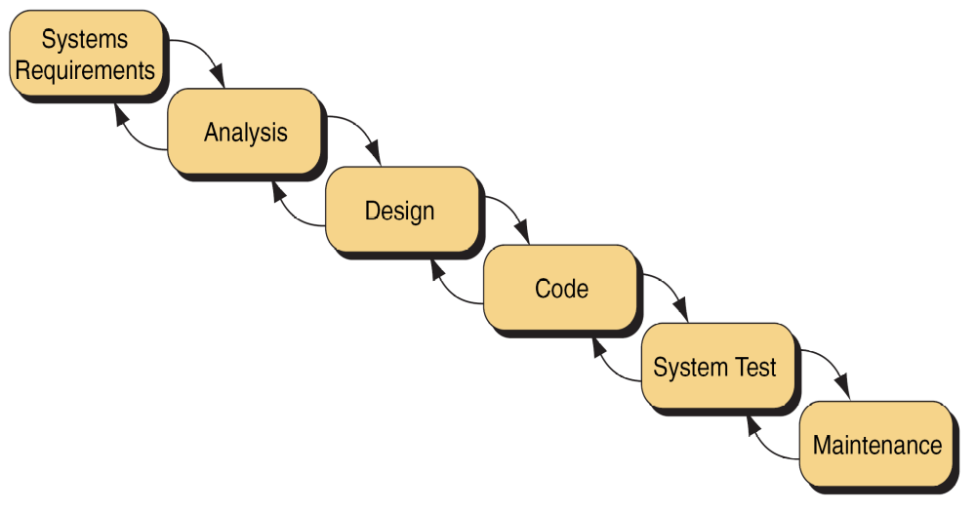
Waterfall model has 6 phases.
Waterfall Model

Slide 42
-+
System Requirements: If programmer knows what exactly customer wants then he can easily develop the project. The systems analyst collects the requirements from the client.
Analysis: Looks at different alternatives from a system’s point of view.
Design: It determines how the system will be built. Also provides the flowchart or algorithm for the program.
Coding: Implement the program using computer programming languages.
Testing: It ensures that the project works well without any errors.
Maintenance: Keeps the system/project working once it has been put into production.

Slide 43
Program Development
It is a multistep process that requires that:
1. Understand the problem
2. Develop Solution
1. Structure Chart
2. Algorithm / Pseudo code
3. Flowchart
3. Write the program
4. Test the program

Slide 44
Understand the Problem
The first step in solving any problem is to understand it.
To solve any problem first you must understand the problem by reading the requirements of the problem.
Once you understand it, review with user(customer) and system analyst.

Slide 45
Develop the Solution
To develop a solution to a problem the following tools are needed.
Structure Chart:
It is also known as a hierarchy chart, shows the functional flow
through your program.
It shows how the problem is broken into logical steps, each step will be a separate module.
It also shows the interaction between all the parts of your program.
It is like the architect’s blueprint.
The below two are used to design the individual parts of the program.
Algorithm / Pseudo Code
Flowchart

Slide 46
Example for Structure Chart
Buy a Computer
Get Configuration
Calculate
Print Report
Desktop
Laptop
DELL
HP
DELL
HP

Slide 47
Algorithm
Algorithm: It is an ordered sequence of unambiguous and well-
defined instructions that performs some task and halts in finite time
Let's examine the four parts of this definition more closely.
Ordered Sequence: You can number the step.
Unambiguous and well defined instructions: Each instruction should be clear, understand without difficulty.
Performs some task
Halts in finite time: Algorithm must terminate at some point.
Notes:
c

Slide 48
Properties of an Algorithm:-
Finiteness: An algorithm must terminate in a finite number of steps.
Definiteness: Each step of an algorithm must be precisely and
unambiguously stated.
Effectiveness: Each step must be effective, and can be performed exactly in a finite amount of time.
Generality: The algorithm must be complete in itself.
Input/Output: Each algorithm must take zero, one or more inputs and produces one or more output.

Slide 49
Three Categories of Algorithmic Operations
An algorithm must have the ability to alter the order of its instructions.
An instruction that alters the order of an algorithm is called a control
structure.
Three categories of an algorithmic operations:
1. Sequential operations: Instructions are executed in order
2. Conditional/Selection ("question asking") Operations: A control
structure that asks a true/false question and then selects the next
instruction based on the answer.
3. Iterative Operations (loops): A control structure that repeats the
execution of a block of instructions.

Slide 50
Pseudo-code and Algorithm Construction
Assignment:
variable = "expression"
Input/Output:
Get/enter/read "variable", "variable", ...
Display/print "variable", "variable", ...
Conditional:
1. if "condition"
1.1 (subordinate) statement 1
1.2 etc ...
2. else
2.1 (subordinate) statement 2
2.2 etc ...
Iterative:
3. while "condition"
3.1 (subordinate) statement 1
3.2 etc ...

Slide 51
Pseudo Code
Definition: English-like statements that follow a loosely defined syntax
and are used to convey the design of an algorithm.
Example1: To determine whether a student is passed or not
Pseudo Code:
1. If student's grade is greater than or equal to 60
1.1 Print "passed"
2. else
2.1 Print "failed"
Algorithm:
Begin
1. If grade >= 60
1.1 Print "passed"
2. else
2.1 Print "failed”
End

Slide 52
Example 2: Write an algorithm to determine a student’s final grade
and indicate whether it is passing or failing. The final grade is calculated
as the average of four marks.
Pseudo Code:
1. Input set of 4 marks
2. Calculate their average by summing and dividing by 4
3. if average is below 50
4. Print “FAIL”
5. else
6. Print “PASS”
Algorithm:
Begin
Step 1: Input M1,M2,M3,M4
Step 2: GRADE ← (M1+M2+M3+M4)/4
Step 3: if (GRADE < 50) then
Step 4: Print “FAIL”
Step 5: else
Step 6: Print “PASS”
Step 7: endif
End

Slide 53
Example3: Pseudo-code example to calculate your quiz average (Iteration)
1. get number of quizzes
2. sum is equal to 0
3. count is equal to 0
4. while count is less than number of quizzes
4.1 get quiz grade
4.2 add sum and quiz grade and then store it in sum
4.3 add one to count
5. Divide sum with number of quizzes and then store the result in average
6. display the average
7. halt

Slide 54
Flowchart
Pictorial representation of an algorithm is called flowchart.
or
A diagram that uses graphic symbols to depict the nature and flow of the steps in a process.

Slide 55
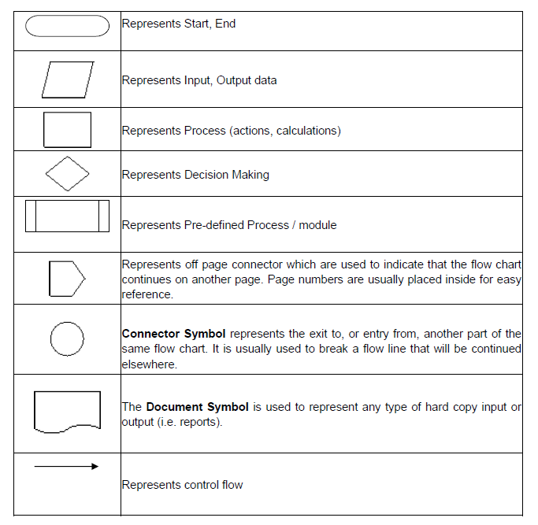
SYMBOLS USED WITH FLOWCHARTS

Slide 56
Flowchart to find the addition of two numbers
Start
Accept a, b
c = a + b
Display C
End

Slide 57
  Algorithm to find whether a given year is a leap year or not.
  Algorithm:
  BEGIN
  Step 1: Accept the YEAR
  Step 2: if (YEAR %4 == 0) then
  Display “Year is a leap year”
  else
  Display “Year is not a leap year”
  end if
END

Slide 58
Flowchart to find whether a given year is a leap year or not
Start
Accept year
if(year%4 = = 0)
false
true
Display non leap year
Display leap year
End

Slide 59
Exercise:
1. Sum of the digits of a number.
2. Nature of quadratic equations.
3. Income tax problem.
4. Standard deviation.

